Slide 1




NEXT GEN EMPLOYABILITY PROGRAM
Creating a future-ready workforce
Team Members
College Name
Student Name : SANJANA .P
Student ID :613021104084
Vivekanandha College Of Technology For Women

Slide 2

CAPSTONE PROJECT SHOWCASE
Project Title
Notes Sharing Web Application using Django Framework
Abstract | Problem Statement | Project Overview | Proposed Solution | Technology Used | Modelling & Results | Conclusion

Slide 3
Abstract In the realm of collaborative learning and knowledge exchange, the development of a web application for sharing notes plays a pivotal role. This abstract presents the conceptualization and implementation of such a platform using the Django framework. The web application is designed to facilitate seamless sharing and collaboration among users in creating, editing, and managing notes. The key features include user authentication, note creation and editing, sharing notes with specific users or groups, real-time collaboration, version control, and access management. Utilizing Django's powerful MVC architecture, the application ensures robust security measures, such as user authentication and authorization, to safeguard user data and privacy. The integration of Django's ORM simplifies database management, enabling efficient storage and retrieval of notes and user information. Furthermore, the web application leverages Django's templating engine to create dynamic and responsive user interfaces, enhancing the user experience across devices . Access management features enable users to share notes selectively, maintaining confidentiality and control over shared content.

Slide 4
Problem Statement The objective of this project is to develop a notes sharing web application using the Django framework.This project aims to address the limitations in existing platform by creating a user-friendly and feature-rich web application specifically designed for sharing, organizing, and collaborating on academic notes The key challenges that this project will include:
Ease of Use
Collaborative Features
Scalability
Security and Privacy
Customization

Slide 5
Project Overview The project aims to develop a web application using the Django framework that facilitates the sharing, organization, and collaboration of academic notes. Key Features:
User Registration and Authentication
Notes Upload and Organization
Search and Filtering
Customization Options
Security and Privacy

Slide 6
Proposed Solution
.
User Authentication and Profile Management:
Implement user registration and login functionalities using Django's built-in authentication system.
Allow users to manage their profiles, including profile pictures, contact information, and preferences.
Notes Management:
Develop a user-friendly interface for uploading notes, including support for various file formats such as PDFs, documents, and images.
Implement features for organizing notes into categories, subjects, or custom tags for easy navigation and search.
Search and Filtering:
Develop robust search functionality to allow users to search for notes based on keywords, categories, tags, or user-specific filters.
Implement advanced filtering options to refine search results and improve user experience.

Slide 7
Security and Privacy:
Ensure data security through secure authentication methods, encrypted data storage, and HTTPS protocol for secure communication.
Implement access control mechanisms to manage permissions for sharing notes, ensuring privacy and confidentiality
Responsive Design and Cross-Platform Compatibility:
Design the web application with a responsive layout to ensure compatibility and optimal user experience across devices, including desktops, tablets, and mobile phones.
Utilize HTML5, CSS3, and JavaScript frameworks like Bootstrap for responsive design and interactivity.

Slide 8


Technology Used
Front-end
Back-end

Slide 9
Modelling & Results
Data Modeling:
User Model
Note ModelS
earch Model
Activity Log Mode
Result
A fully functional web application accessible via web browsers on various devices.
User-friendly interface for uploading, organizing, sharing, and collaborating on notes.
Secure authentication and access control mechanisms to protect user data and ensure privacy.

Slide 10
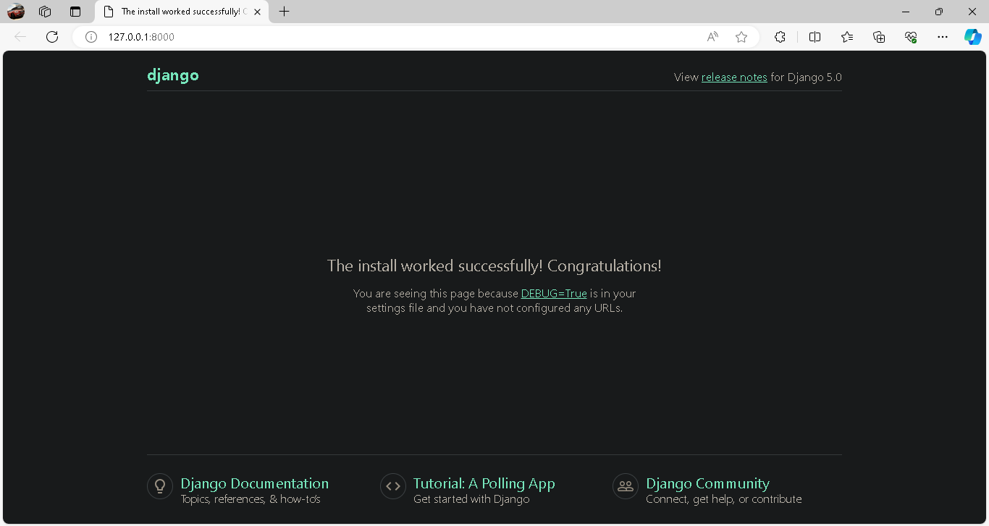
User Signup Form

Slide 11
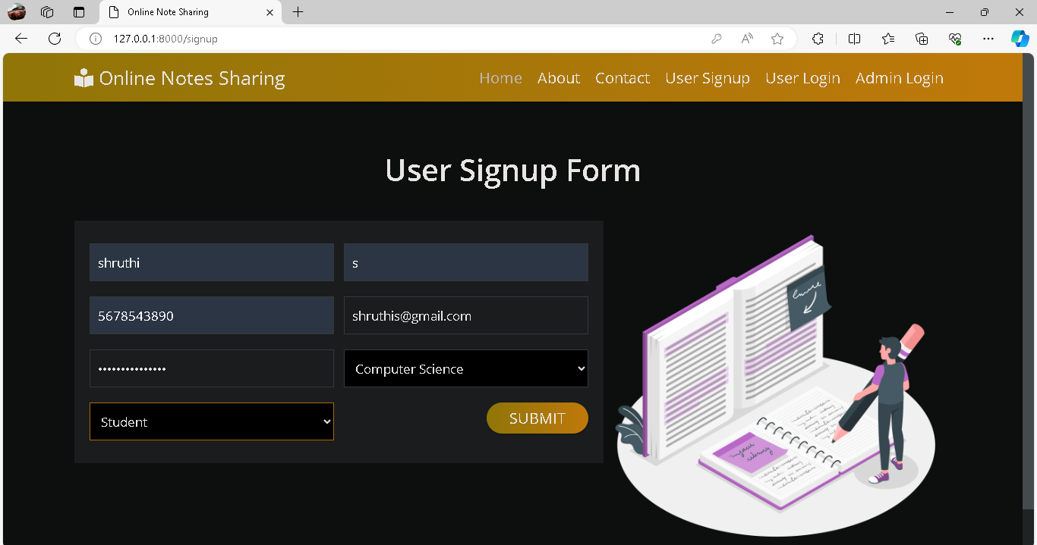
User signup Page

Slide 12
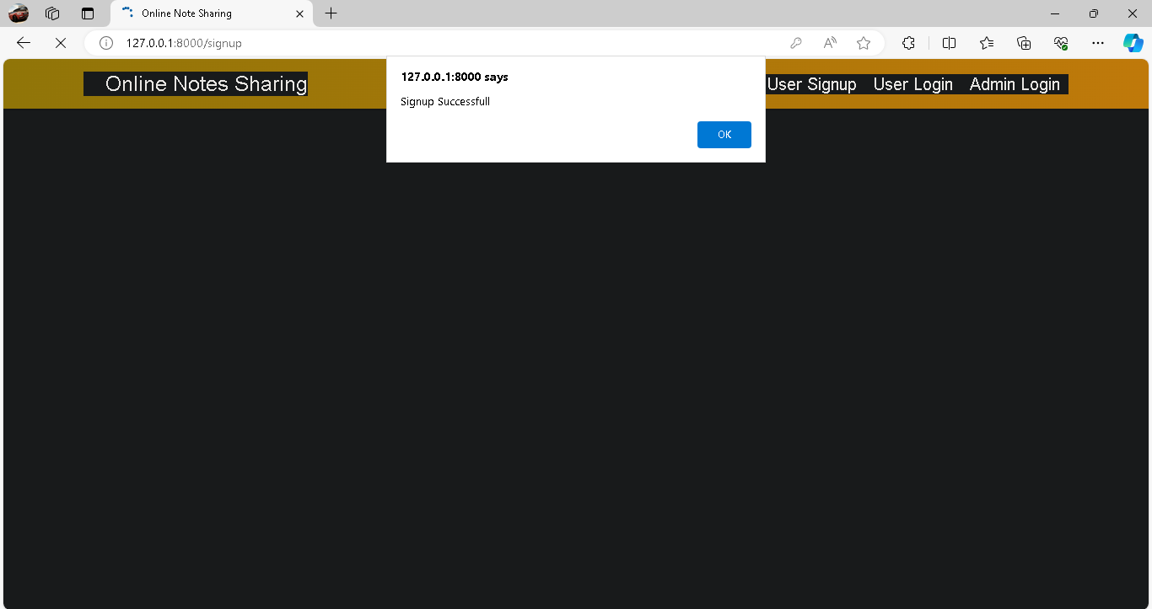
Signed in successful message

Slide 13
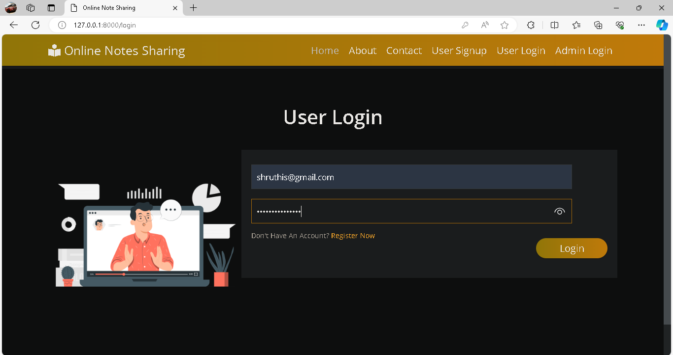
Login page

Slide 14
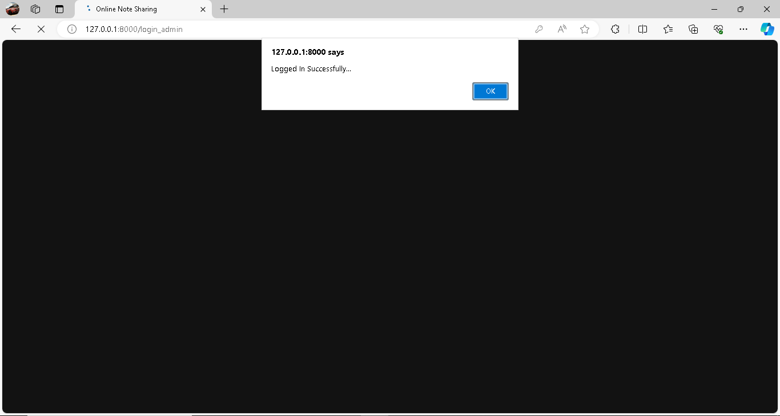
Login successful message

Slide 15
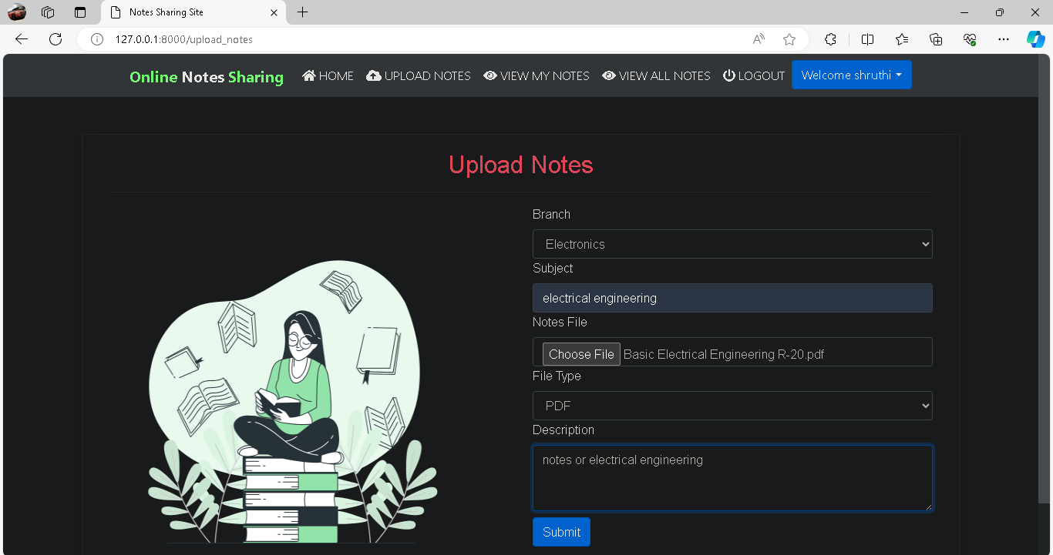
Notes uploading

Slide 16
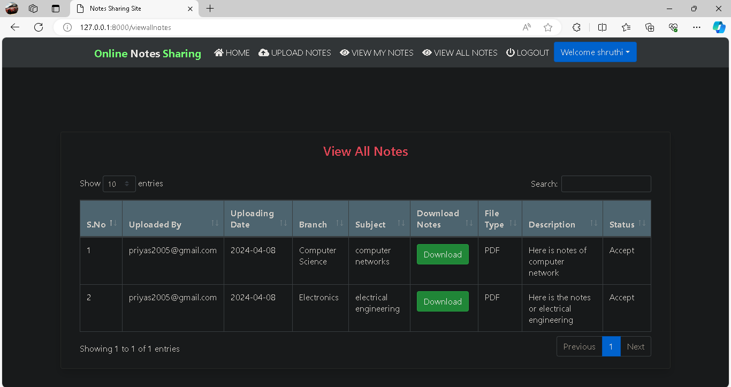
View notes

Slide 17
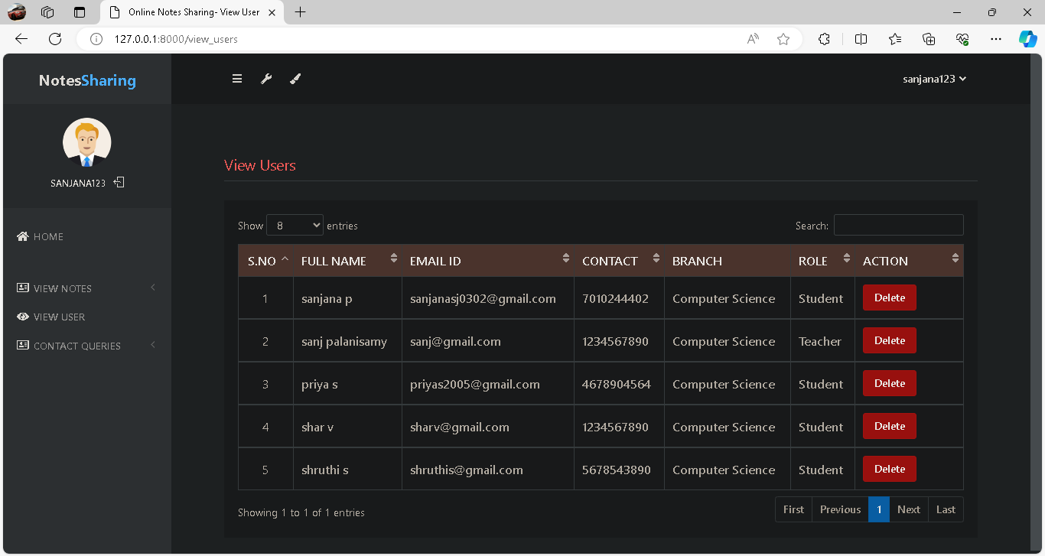
Users

Slide 18
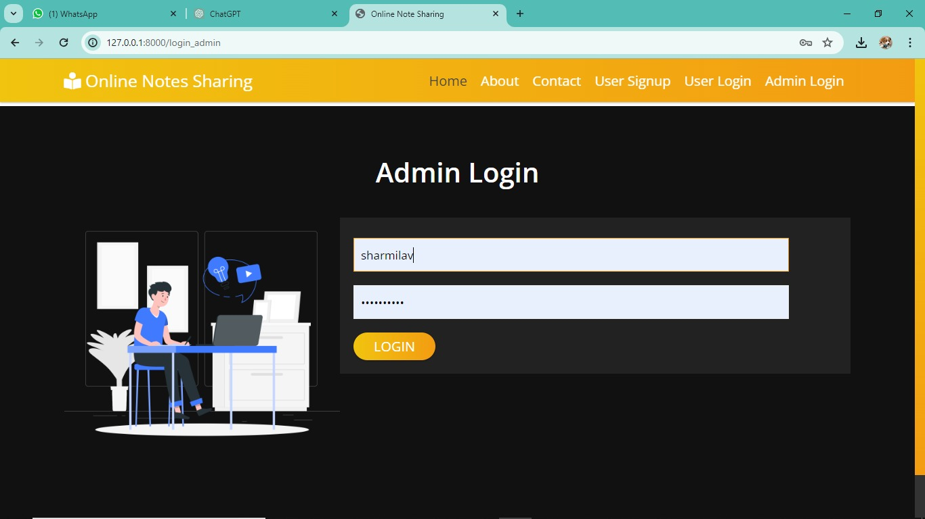
Admin page

Slide 19
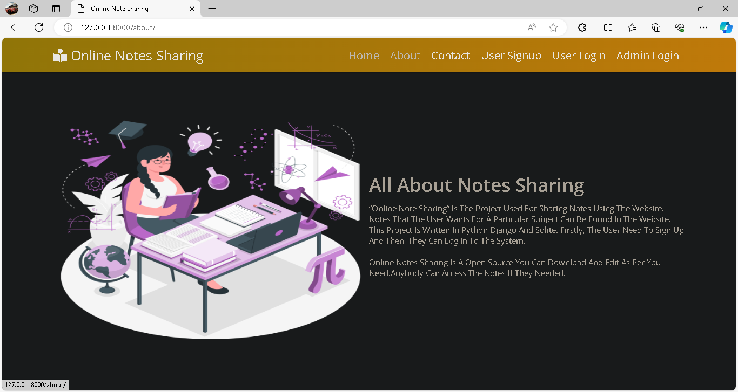
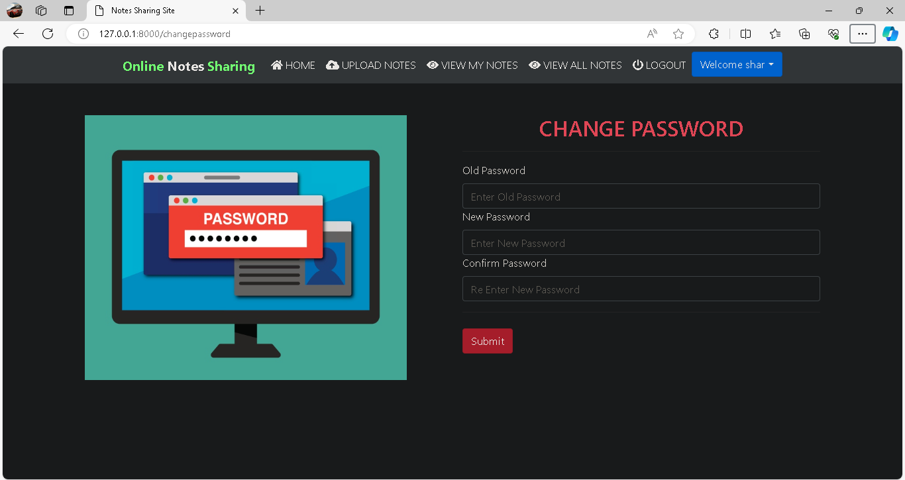
About notes sharing
To change password

Slide 20
Future Enhancements:
Mobile App Development
Enhanced Collaboration Features
Advanced Search and Recommendation System
Gamification and Rewards System
Accessibility Features
Integration with AI Assistants

Slide 21
Conclusion
The notes sharing web application using Django framework presents a robust solution for improving collaboration, knowledge sharing, and organization of academic materials within educational communities. With its user-friendly interface, real-time collaboration features, and secure data management, the application aims to enhance the learning experience for students and educators alike.
Moving forward, future enhancements such as advanced collaboration tools, personalized recommendations, integration with LMS platforms, mobile app development, analytics capabilities, and gamification elements can further elevate the functionality and value of the application. These enhancements will cater to evolving user needs, foster engagement, and promote a culture of continuous learning and collaboration
Source :

Slide 22
Thank You!
Notes:
Thank You !!

